Slide 1
Input To SOS Using VisualState

Slide 2
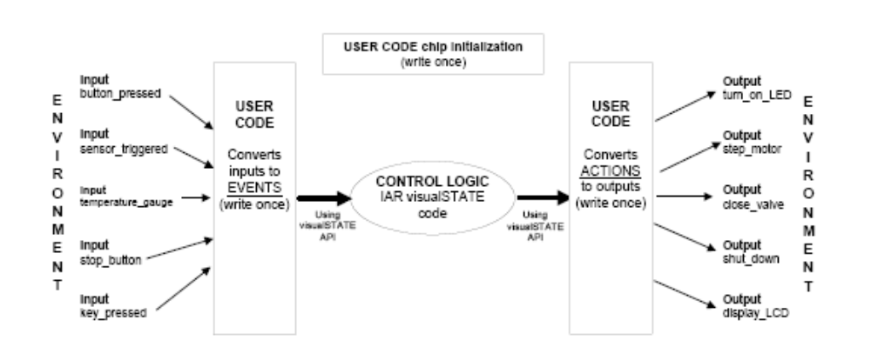
Assumptions
Familiar with statechart terminolgoy
Worked with SOS and can write a program to do the job otherwise. VS just makes things easier

Slide 3
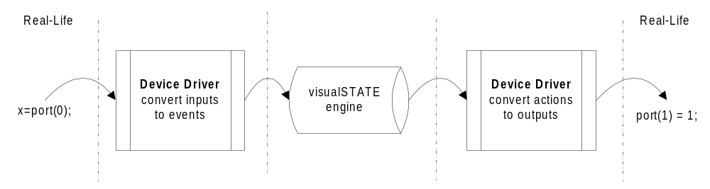
Fundamental Idea
Since a diagrammatic and event driven approach is more intuitive and easy to think in terms of and its easier and faster if we are able to implement that.
IAR’s VS initially aimed at using device drivers and behaving as the main system. The idea we have is to give it to use VS to write modules so that we have to do nothing extra (On the SOS side) to integrate it with SOS.

Slide 4
Fundamental Idea
Real World
SOS
VS
IAR had given an idea of using device drivers for interaction with the real world. So our approach has been similar
Further the device drivers was something that was going to convert SOS events to VS events and the above structure is to be followed strictly

Slide 5
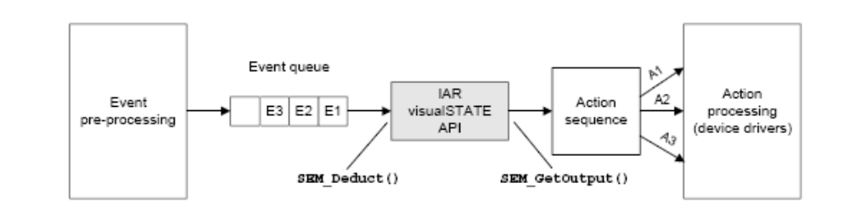
Implementation
A simple case switching was used so that at the occurances of the SOS events corresponding VS events are queued.
Since SOS follows event driven programming the infinite loop of the main system of VS was replaced by a loop whose execution lasts till all the events are not dequeued
An important question is wether we need a queue at all (interupts are the point to take into consideration)

Slide 6
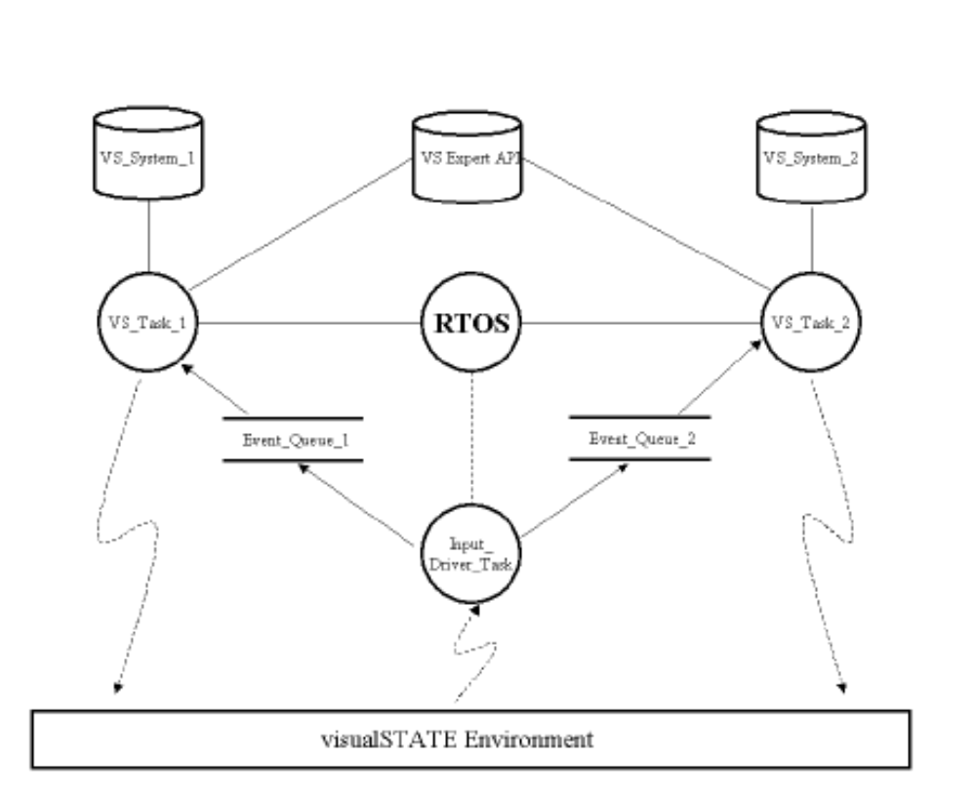
The Choice
It important to decide between the following two implementations
Separate Modules-traffic
If one module then same as one super and state
Issues like parameterization
VS_System
Basic API

Slide 7
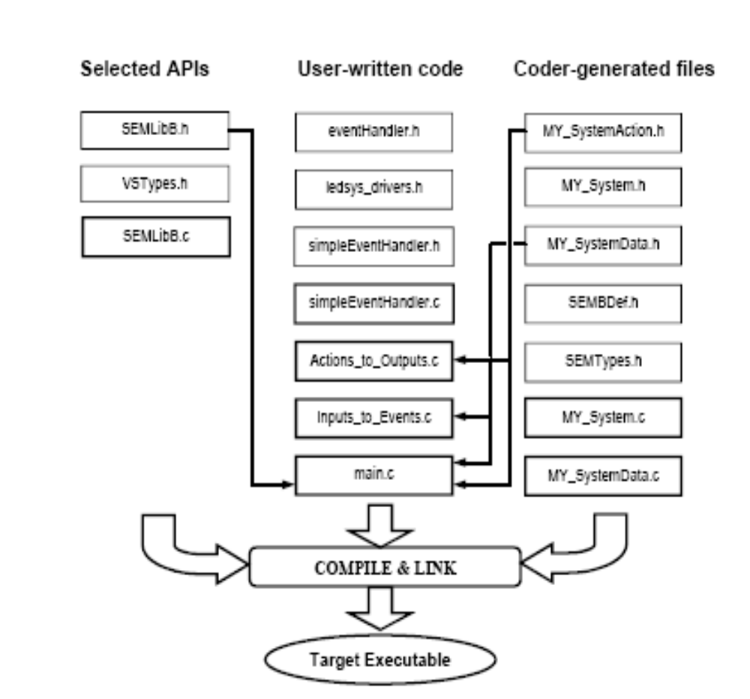
Implementation

Slide 8
Results
Well I have a running application and am testing the system.
Blink (hardcoded) = 150 bytes
Blink (VS)=2140 bytes
This seems like a large increase but this is more like the state machines internal variables etc. As the number of states increases and the complextiy the efficiency increases

Slide 9
Drawbacks
Well Apart from the code size the only drwaback seems to be the number of checks that needs to be performed. (processor resources)

Slide 10
Current Exploration
Well the other way of using the Expert API to increase code efficiency in case multiple systems running in a single project is being explored

Slide 11
Testing Models
Well For the effectiveness of VS a basic input only and an input and output application is being used
For Comparison between the two API’s which will not depend upon SOS I will use data from the internet but will implement all that for which the Basic API is used and explained.

Slide 12
Questions & Discussion
PS: I can show u VS if needed

